Slide 1
Docker Containers and Azure
Corey Sanders
Director of Program Management
Microsoft Azure

Slide 2




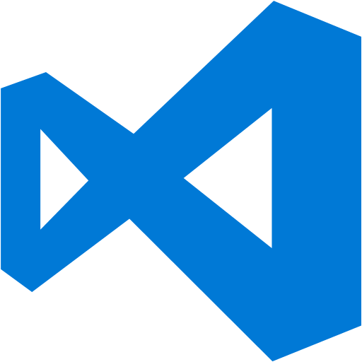
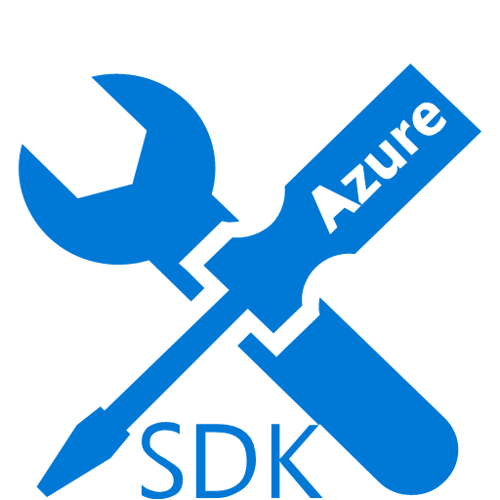
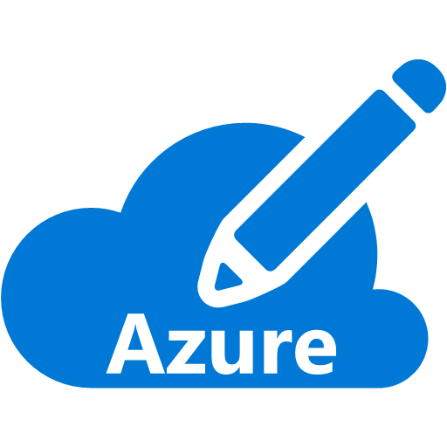

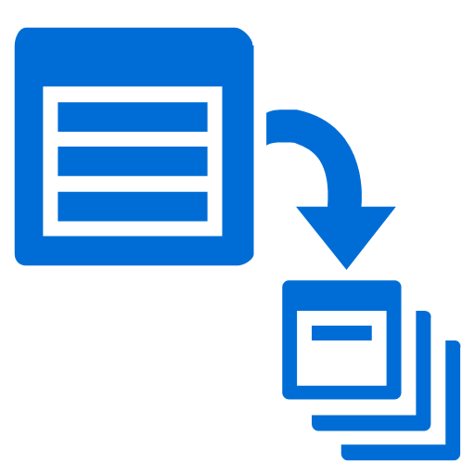

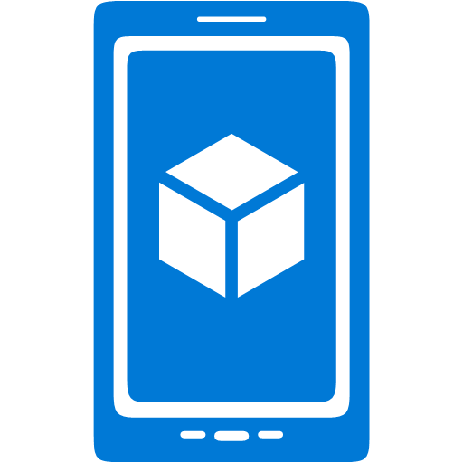







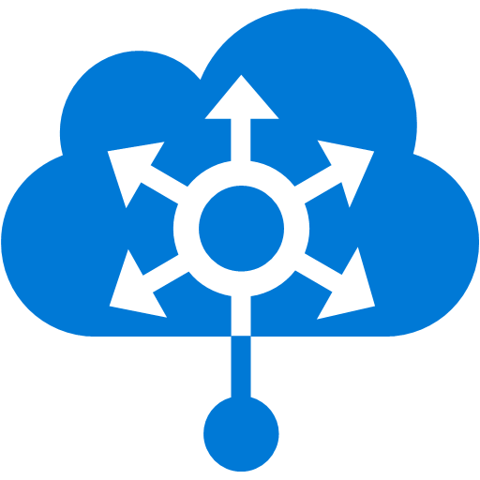



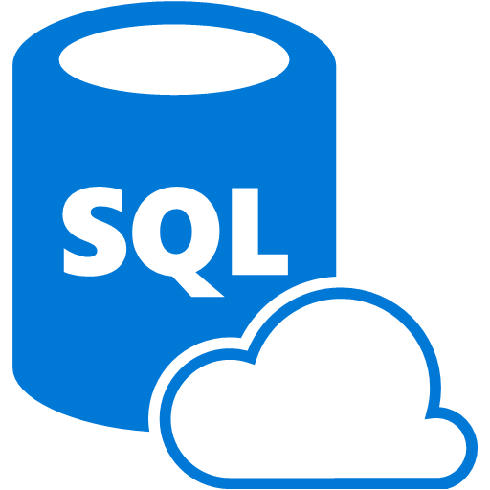









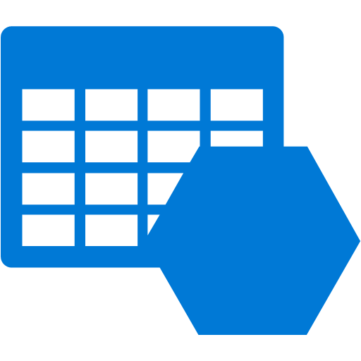





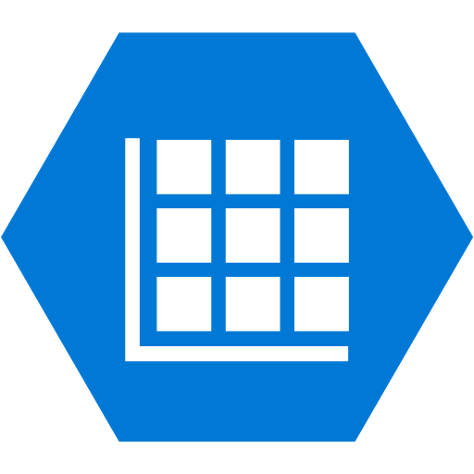




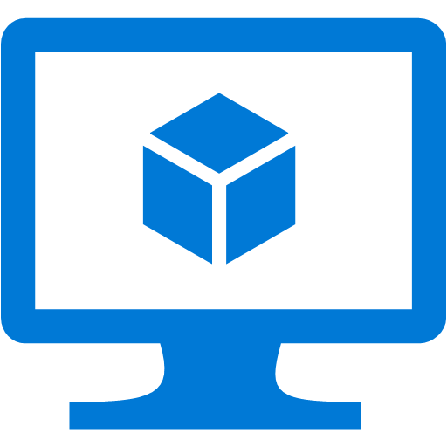








Platform Services
Security & Management
Compute
Web and Mobile
Developer Services
Hybrid
Operations
Cloud
Services
Service
Fabric
Web Apps
API
Apps
API
Management
Visual Studio
Azure SDK
Portal
Azure AD
Connect Health
Batch
Remote App
Mobile
Apps
Logic
Apps
Notification
Hubs
Team Project
Application
Insights
Active
Directory
AD Privileged
Identity
Management
Multi-Factor
Authentication
Integration
Analytics & IoT
Data
Backup
Storage
Queues
Biztalk
Services
Automation
HDInsight
Machine
Learning
SQL
Database
SQL Data
Warehouse
Operational
Insights
Hybrid
Connections
Service
Bus
Key Vault
Data
Factory
Event
Hubs
Redis
Cache
Search
Import/Export
Store /
Marketplace
Media & CDN
Site
Recovery
Stream
Analytics
Mobile
Engagement
DocumentDB
Tables
VM Image Gallery
& VM Depot
Media
Services
Content Delivery
Network (CDN)
StorSimple
Infrastructure Services
Compute
Storage
Networking
Virtual Machines
Containers
BLOB Storage
Azure Files
Premium Storage
Virtual Network
Load Balancer
DNS
Express
Route
Traffic Manager
VPN Gateway
Application Gateway
Datacenter Infrastructure (24 Regions, 19 Online)

Slide 3
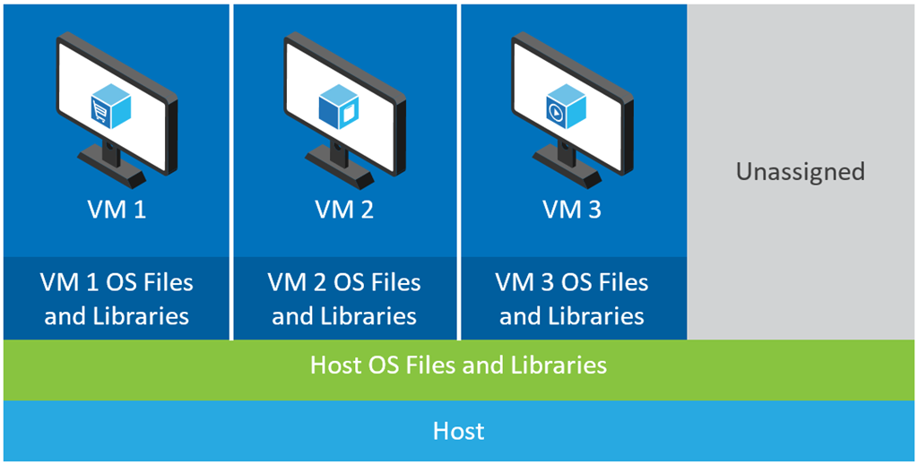
What are containers?
Virtualization technology
Isolated and independent
Resource governance
Container 1
Container 2
Container 3
Unassigned
Host and VM OS files and libraries
Host

Slide 4
Containers Technical overview
Container
Dependencies: Every application has it’s own dependencies which includes both software (services, libraries) and hardware (CPU, memory, storage)
Virtualization: Container engine is a light weight virtualization mechanism which isolates these dependencies per each application by packaging them into virtual containers
Shared host OS: Processes in containers are isolated from other containers in user space, but share the kernel with the host and other containers
Flexible: Differences in underlying OS and infrastructure are abstracted away, streamlining “deploy anywhere” approach
Fast: Containers can be created almost instantly, enabling rapid scale-up and scale-down in response to changes in demand
App A Bins/libraries
App B Bins/libraries
Host OS w/Container support
Server

Slide 5
Containers How do they differ from virtual machines?
Virtual Machine
Container
Dependencies: Each virtualized app includes the app itself, required binaries and libraries and a guest OS, which may consist of multiple GB of data
Independent OS: Each VM can have a different OS from other VMs, along with a different OS to the host itself
Flexible: VMs can be migrated to other hosts to balance resource usage and for host maintenance without downtime
Secure: High levels of resource and security isolation for key virtualized workloads
App B Bins/libraries
App A Bins/libraries
App B Bins/libraries
App A Bins/libraries
Guest OS
Guest OS
Host OS w/Container support
Hypervisor
Server
Server

Slide 6
Containers and virtual machines Deployment options suited to many scenarios
Virtual Machine
Spotlight capabilities
Container
Containers in VMs: By combining containers with VMs, users can deploy multiple, different VM operating systems, and inside, deploy multiple containers within those guest OSs.
By combining containers with VMs, fewer VMs would be required to support a larger number of apps.
Fewer VMs would result in a reduction in storage consumption.
Each VM would support multiple isolated apps, increasing overall density.
Flexible: Running containers inside VMs enables features such as live migration for optimal resource utilization and host maintenance.
App A Bins/Libraries
App A Bins/Libraries
App B Bins/Libraries
Guest OS
Guest OS w/ Container Support
Hypervisor
Server

Slide 7
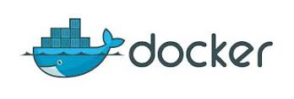
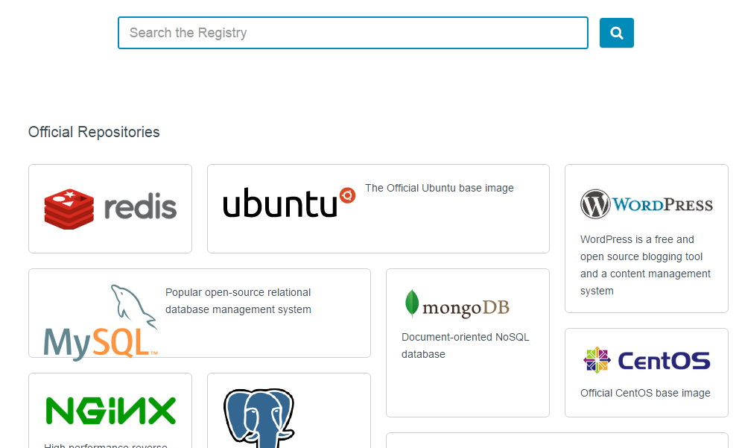
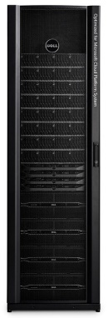
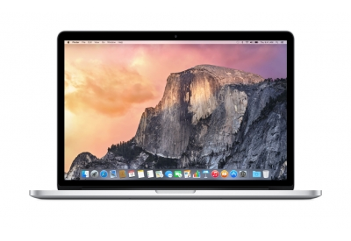
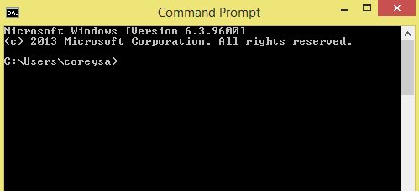
How containers are being used? Why is everyone so excited?
Fast and agile!!!
Unified deployment technology
Unified packaging format
Huge community
Prod
Dev
Test

Slide 8
Demos
A Linux Container

Slide 9
Show a running Linux VM.
SSH into the VM
sudo apt-get update
curl -sSL https://get.docker.com/ | sh
sudo docker run hello-world
Docker pull Ubuntu
Run an interactive shell –
docker run -i -t ubuntu /bin/bash
-i starts with interactive
-t pseudo TTY
docker ps # Lists only running containers
docker ps -a # Lists all containers
docker stop
docker start
# Commit your container to a new named image
$ docker commit <container> <some_name> # List your images $ docker images
docker run -d –p 80:5000 training/webapp python app.py
docker run -d -P training/webapp python app.py
40.114.13.108

Slide 10
Windows Server Containers Anatomy and key capabilities
Container A
Container B
Container C
Build: Developers will use familiar development tools, such as Visual Studio, to write apps to run within containers
By building modular apps leveraging containers, modules can scale independently, and be updated on independent cadences
Run: Container capabilities built into Windows Server
Manage: Deploy and manage containers using Docker (or PowerShell).
Resources: Define CPU and memory resources per container along with storage and network throughput
Web tier
App tier
DB tier
LOB app (+Binaries)
LOB app (+Binaries)
LOB app (+Binaries)
Libraries (Shared across containers)
Libraries
Host OS w/Container Support
Server (Physical or Virtual)

Slide 11


Docker integration Joint strategic investments to drive containers forward
Customer
Datacenter
Docker: An open source engine that automates the deployment of any application as a portable, self-sufficient container that can run almost anywhere
Partnership: Enable the Docker toolset to manage multi-container applications using both Linux and Windows containers, regardless of the hosting environment or cloud provider
Dockerized app
Windows Server
Container
Linux Container
Run anywhere
Microsoft
Azure
Service
Provider
Docker
Investments in the next wave of Windows Server
Open source development of the Docker Engine for Windows Server
Azure support for the Docker Open Orchestration APIs
Federation of Docker Hub images into the Azure Gallery and Portal
Strategic investments

Slide 12


Docker integration Joint strategic investments to drive containers forward
Docker Hub in Azure: Huge collection of open and curated applications available for download
Collaboration: Bring Windows Server containers to the Docker ecosystem to expand the reach of both developer communities
Docker Engine: Docker Engine for Windows Server containers will be developed under the aegis of the Docker open source project
Docker client: Windows customers will be able to use the same standard Docker client and interface on multiple development environments
Docker Client
Docker.exe
Examples:
docker run
docker images
Windows Server
Linux
Docker Remote API
Examples:
GET images/json
POST containers/create
Docker Engine
(Daemon)
Docker Engine
(Daemon)
Windows Server
Container Support
Linux Container
Support (LXC)

Slide 13
Demos
A Windows Container

Slide 14
docker run -it --name dockerdemo windowsservercore cmd
docker commit dockerdemo newcontainerimage
Docker images
Created an image with NGINX ahead of time. Created a firewall rule to open up the required ports on 80.
docker run -it --name nginxcontainer -p 80:80 nginx_windows cmd
cd c:\nginx\nginx-1.9.3
start nginx
40.121.55.209

Slide 15

Containers
Creation, deployment, and management
Developers update, iterate, and deploy updated containers
Physical/Virtual Servers
2
3
Operations collaborates with developers to provide app metrics and insights
Developers build and test apps in containers, using development environment
Operations automates deployment and monitors deployed apps from central repository
1
2
Containers pushed to central repository

Slide 16
The DevOps experience
Fast iteration
Rapid deploy
SysAdmin ease
How do you empower developers to create innovative applications at a competitive rate without disrupting IT’s ability to manage servers and maintain control?
Dev
Test
Prod
Containers

Slide 17
Demos
Docker Hub on Azure

Slide 18
Hyper-V Containers
Anatomy and key capabilities
Hyper-V Container
Hyper-V Container
Consistency: Hyper-V containers use the same APIs Windows Server Containers ensuring consistency across management and deployment toolsets
Compatibility: Hyper-V Containers use the exact same images as Windows Server Containers
Strong isolation: each Hyper-V Container has it’s own dedicated copy of the kernel
Highly trusted: built with proven Hyper-V virtualization technology
Optimized: the virtualization layer and the operating system have been specifically optimized for containers
App A Bins/Libraries
App B Bins/Libraries
Windows Guest OS Optimized for Hyper-V Container
Windows Guest OS Optimized for Hyper-V Container
Hypervisor
Server

Slide 19
What’s next for containers on Azure

Slide 20
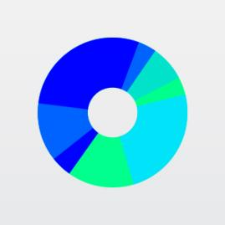
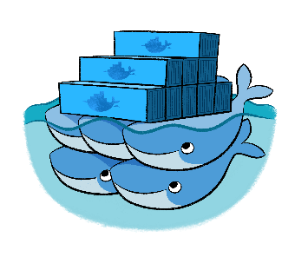

Orchestration Solutions Orchestration Management
Swarm Compose
Marathon
Cloud
Cloud

Slide 21

Azure Container Service
Streamlined provisioning of Apache Mesos Clusters
Layered support of Swarm, Marathon, and Chronos
Docker tooling and API support
Integrated app management and scaling
Linux and Windows Server containers
Public and private cloud

Slide 22
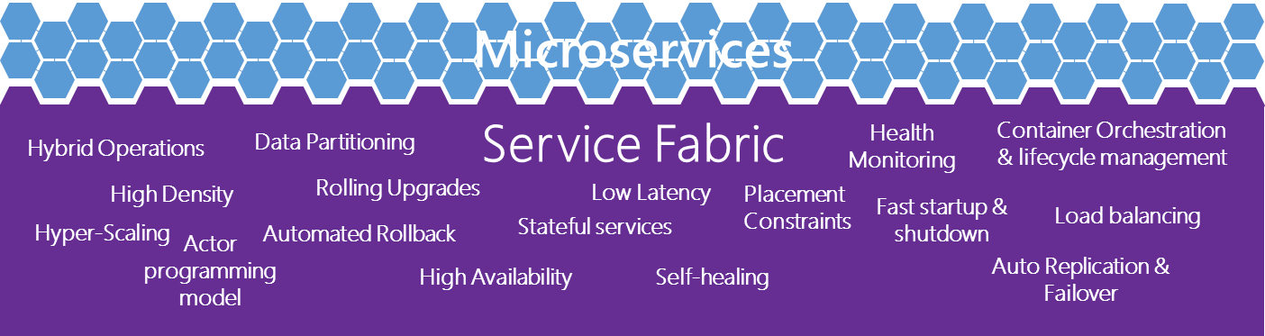
Where containers are going Microservices
Small composed parts
Easy development
Easy scale-out
Easy update
Service fabric

